Slide 1

Credit Card Transactions Fraud Detection CAPSTONE PROJECT – (DG) NIDHI JHA

Slide 2

AGENDA
Problem Statement
Objective
Key Findings
Summary of model evaluation
Cost analysis

Slide 3
Problem Statement
This is a simulated data set taken from the Kaggle website and contains both legitimate and fraudulent transactions. You can download the data set using this link.
https://www.kaggle.com/kartik2112/fraud-detection
The data set contains credit card transactions of around 1,000 cardholders with a pool of 800 merchants from 1 Jan 2019 to 31 Dec 2020. It contains a total of 18,52,394 transactions, out of which 9,651 are fraudulent transactions. The data set is highly imbalanced, with the positive class (frauds) accounting for 0.52% of the total transactions. Now, since the data set is highly imbalanced, it needs to be handled before model building. The feature 'amt' represents the transaction amount. The feature 'is_fraud' represents class labelling and takes the value 1 the transaction is a fraudulent transaction and 0, otherwise.

Slide 4
Objective
Reduce time-consuming manual reviews, costly chargebacks and fees, and denial of legitimate transactions.
Recommend the optimal ways that the bank can adopt to mitigate the fraud risks.

Slide 5
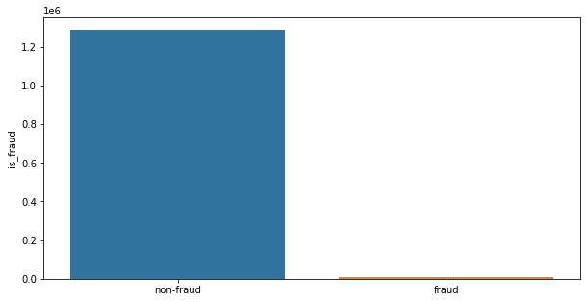
KEY FINDINGS
The dataset contains 12,89,169 of non-fraud cases and 7,506 of fraud cases the ratio to fraud and non-fraud is 0.58 %.

Slide 6
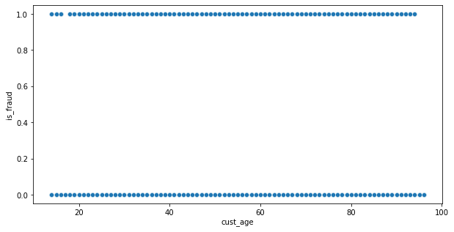
Frauds are happening in all age groups
ANALYSIS ON AGE

Slide 7
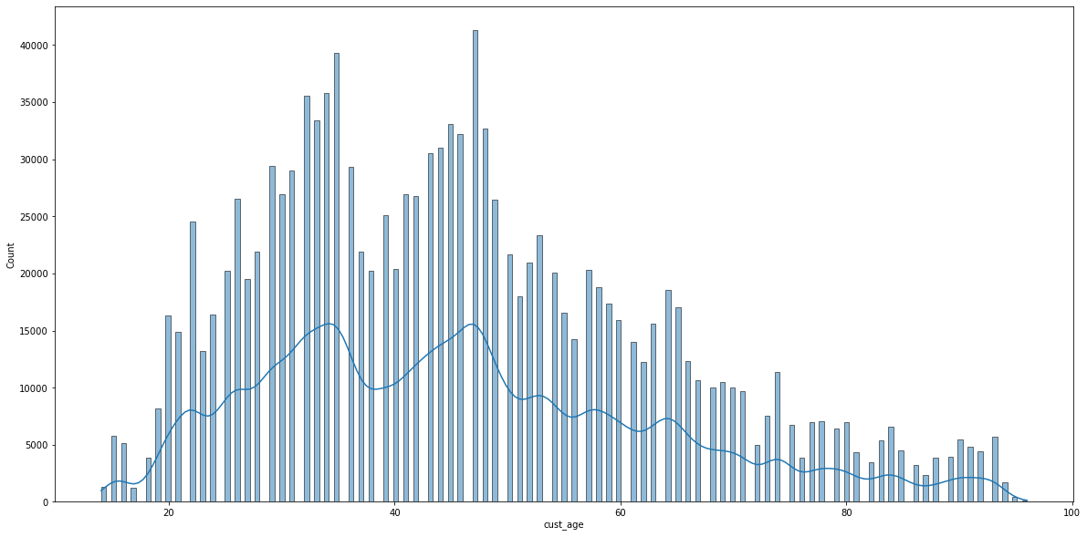
The age group of 25-50 people do transaction more compare to other age group.

Slide 8
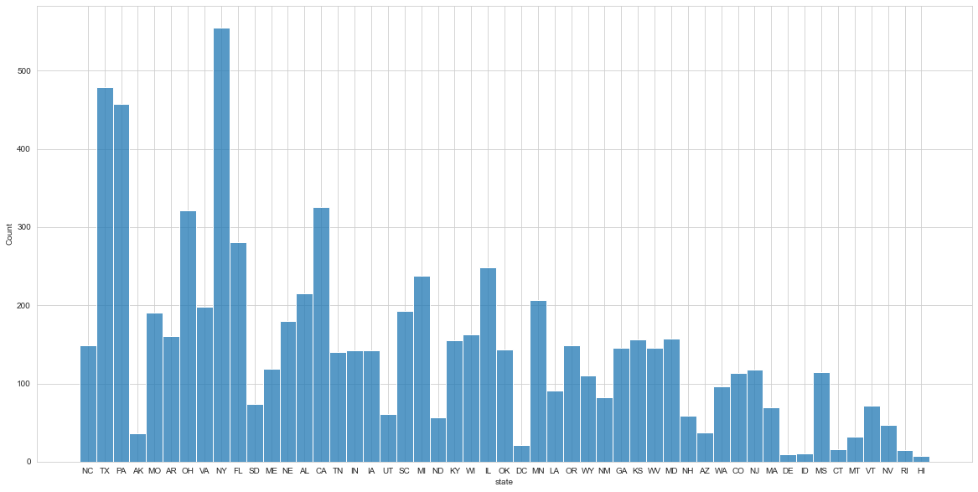
ANALYSIS ON STATE WISE
highest frauds in states
NY 555
TX 479
PA 458
CA 326
OH 321
lowest frauds in states
HI 7
DE 9
ID 11
RI 15
CT 16

Slide 9
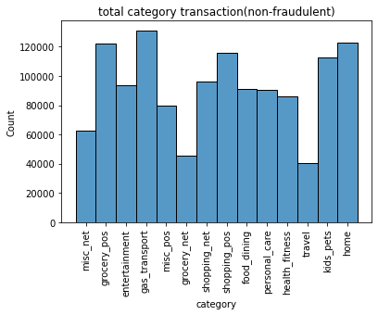
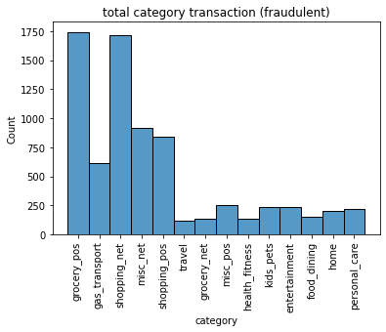
ANALYSIS ON CATOGORY

Slide 10
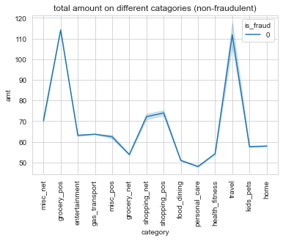
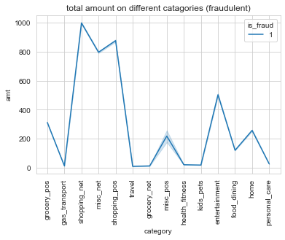

Slide 11
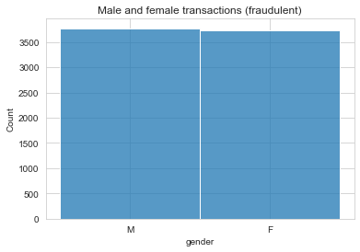
Observations:
shopping_net, groceries_pos, mics_net, and shopping_pos has the most fraudulent transaction catogory.
travel and groceries_pos are the catogories where amount spent on non-fraudelent transaction is maximum.
Frauds happen more slightly more in males compare to females.

Slide 12
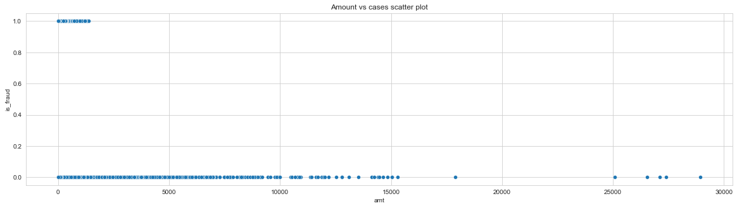
ANALYSIS ON AMOUNT
This Graph Shows the fraudulent happen on particular amount

Slide 13
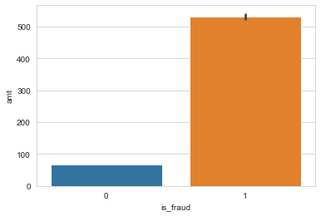
Out of total amount 91222428.9 $, 3988088.61 $ has been fraudulent and i.e 4.0% of total
4% of wealth is effected by frauds.

Slide 14
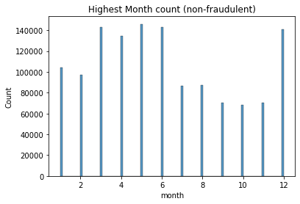
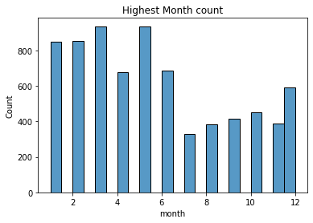
ANALYSIS ON MONTH, DAY AND HOUR

Slide 15
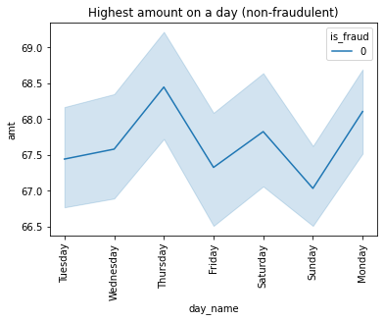
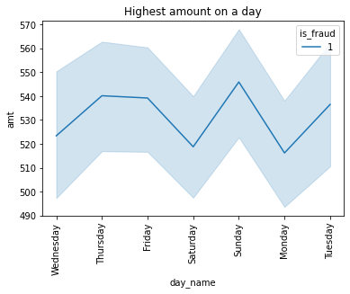

Slide 16
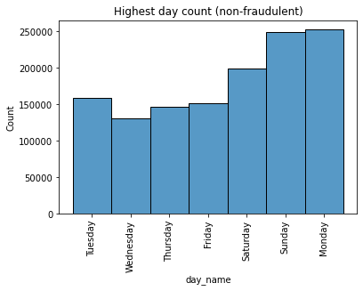
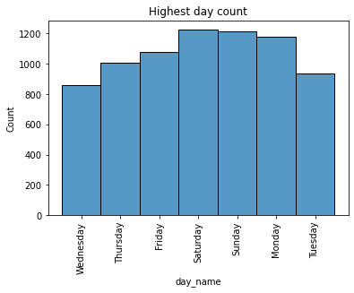

Slide 17
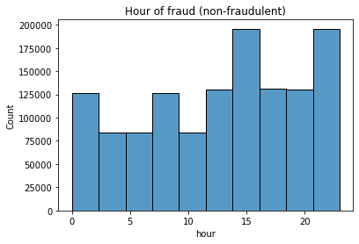
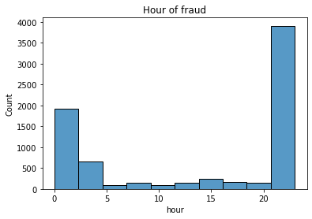

Slide 18
OBSERVATION
April to july and December month has the highest no. of transaction.
1st and 2nd quarter of the year has the most no, of fraudulent transaction and than it drops drastically.
Sunday, Monday and Tuesday have more transaction.
Most of the fraudulent transaction happens on weekends.
Most of the fraudulent transaction happens at night time between 10 pm to 2:30 am.
On Sunday transactions occurs on less amount of money, and also on this day, the maximum money has been stolen the following Tuesday and Thursday.

Slide 19
SUMMARY OF THE EVALUATED MODELS
The Models which I have considered are:-
Logistic regression model
Decision tree model
XGboost model
Sampling Techniques used are:-
SMOTE
ADASYN
I have tested models on training data set also for comparison so, which gives total of 9 models buildings.

Slide 20
The Best Model with Perfect Score is XGBoost with ADASYN as it's sampling technique.
The Scores are as follows:-
SCORE:- FOR TRAINING DATA
Accuracy:- 0.9976
Recall:- 0.9985
f1:- 0.9976
FOR TEST DATA
Accuracy:- 0.9959
Recall:- 0.9160
f1:- 0.7256
we have focused on getting maximum recall in order to detect actual fraudulent transactions in order to save the banks from high-value fraudulent transactions.

Slide 21
Cost-Benefit Analysis
Average number of transactions is 77183.08.
Average number of fraudulent transactions per month is 402.125.
Average amount per fraudulent 530.66.
Cost incurred per month before the model was deployed 213,391.65 $.

Slide 22
THANK YOU

